Slide 1

Notes:
[Sources]
- User-provided source: РАДАР_презентация_v3.26.pdf
- User-provided source: IMG_2762.JPG
- User-provided source: IMG_4648.HEIC

Slide 2
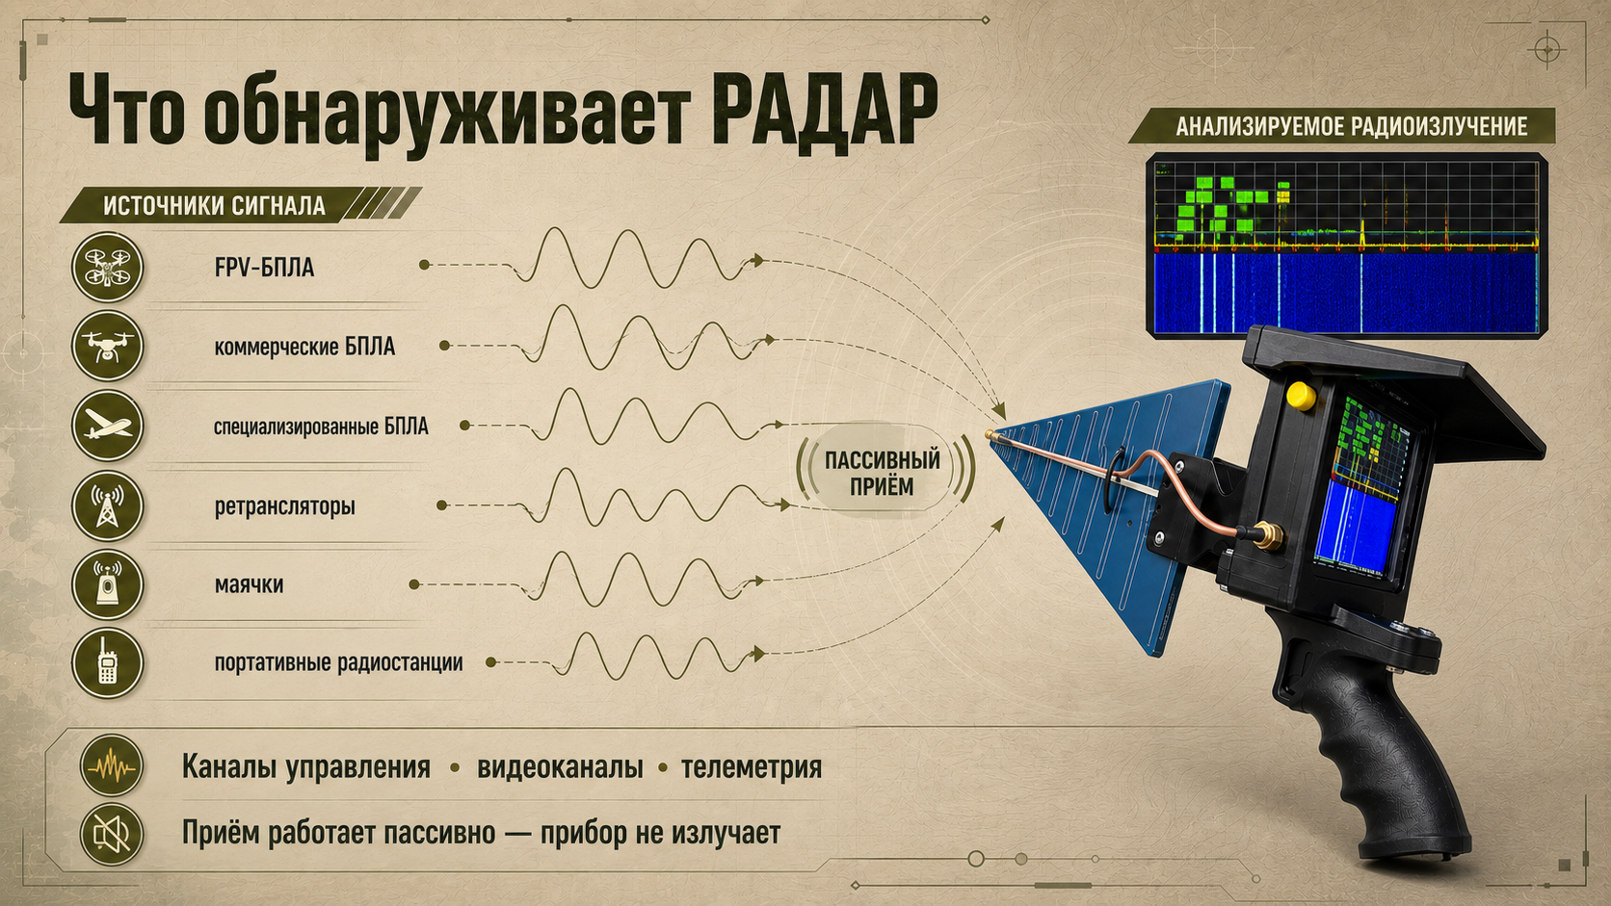
Notes:
[Sources]
- User-provided source: РАДАР_презентация_v3.26.pdf
- User-provided source: техническое описание РАДАРА v3.26.docx
- User-provided source: IMG_2762.JPG

Slide 3
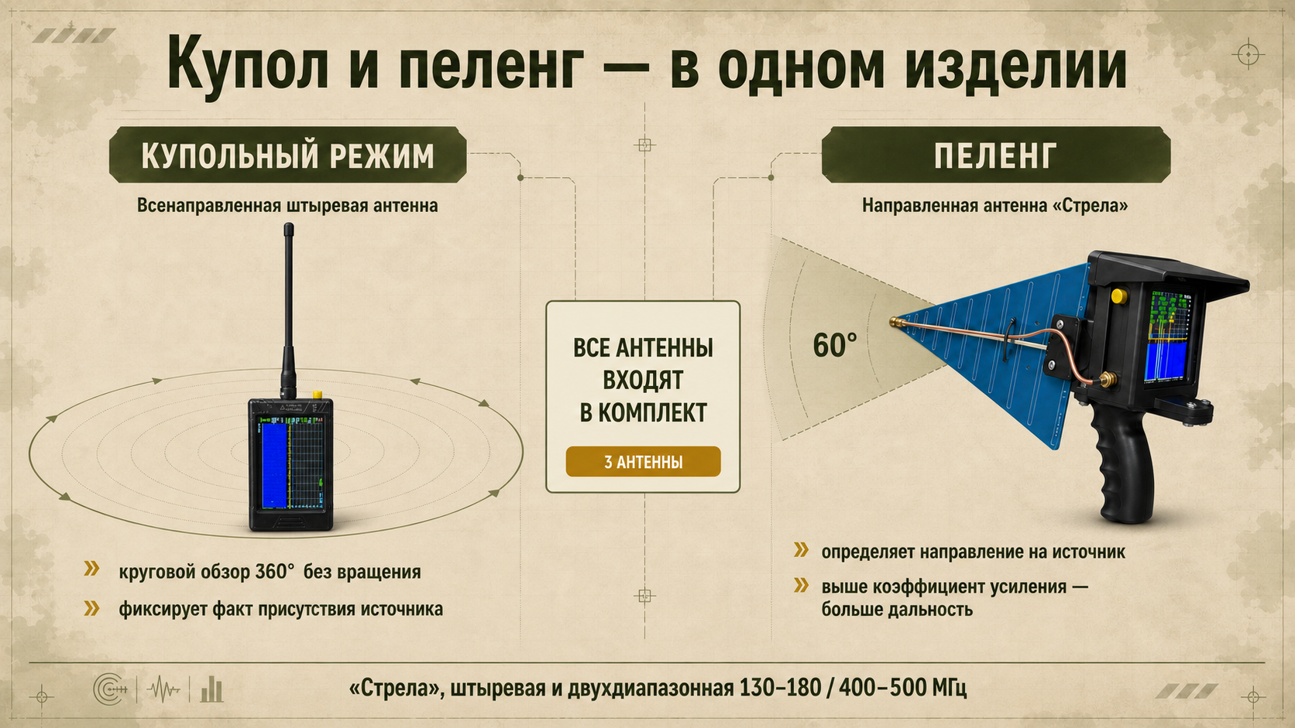
Notes:
[Sources]
- User-provided source: РАДАР_презентация_v3.26.pdf
- User-provided source: IMG_2762.JPG
- User-provided source: IMG_4648.HEIC

Slide 4
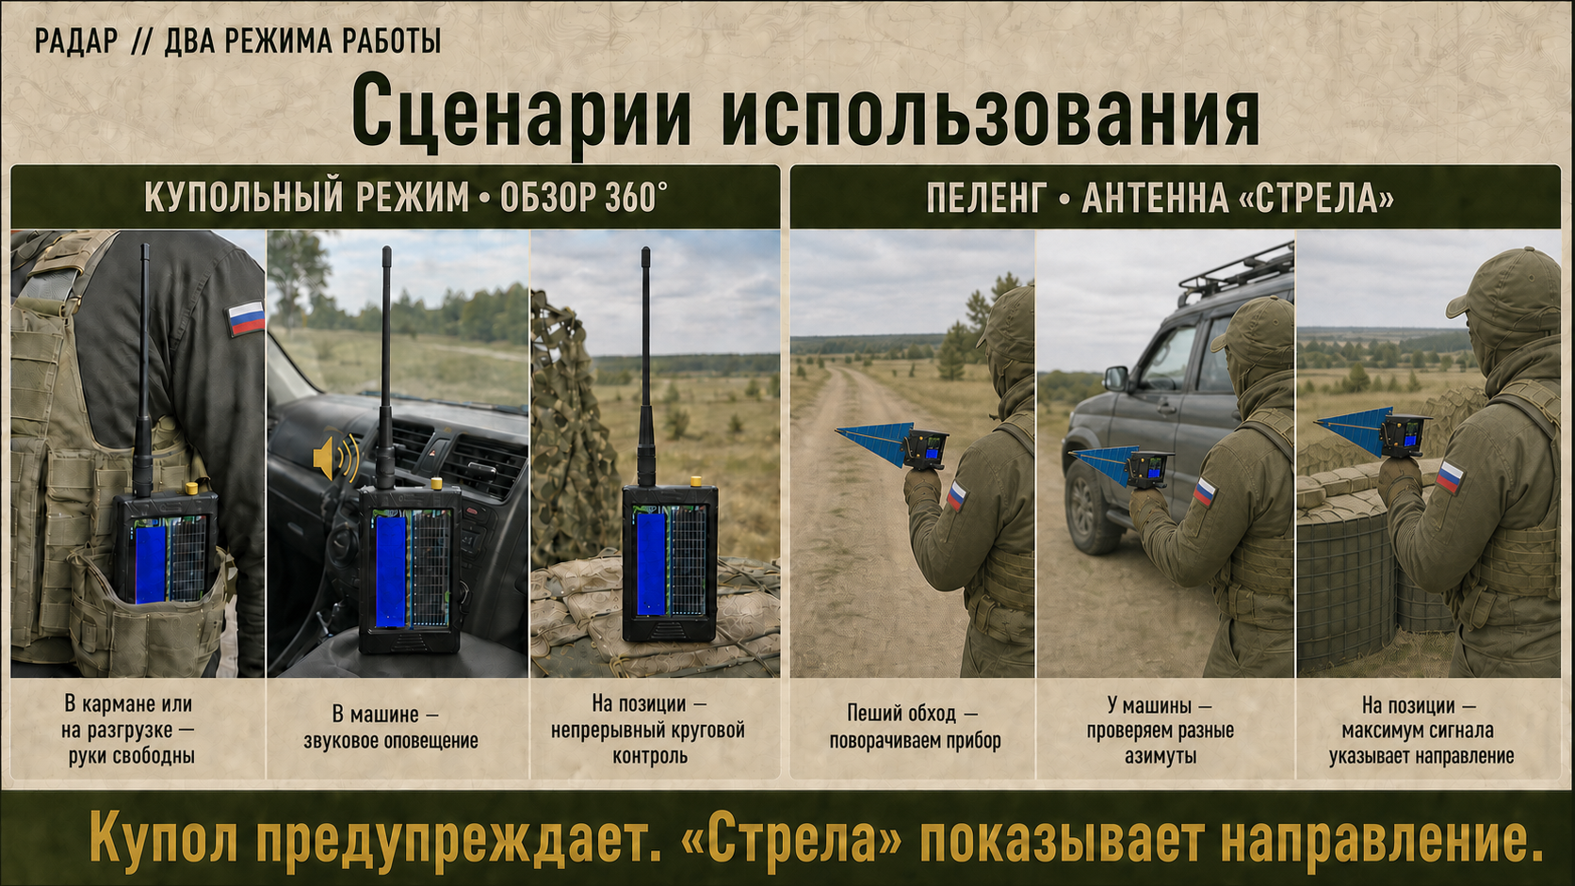
Notes:
[Sources]
- User-provided source: IMG_4809.PNG
- User-provided source: IMG_4808.PNG
- User-provided source: Снимок экрана 2026-08-22 в 14.57.46.png

Slide 5
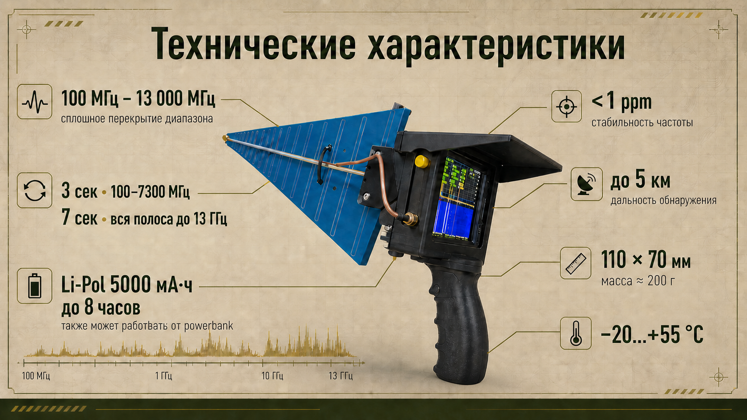
Notes:
[Sources]
- User-provided source: техническое описание РАДАРА v3.26.docx
- User-provided source: IMG_2762.JPG
- User-provided source: Снимок экрана 2026-08-22 в 14.58.27.png

Slide 6
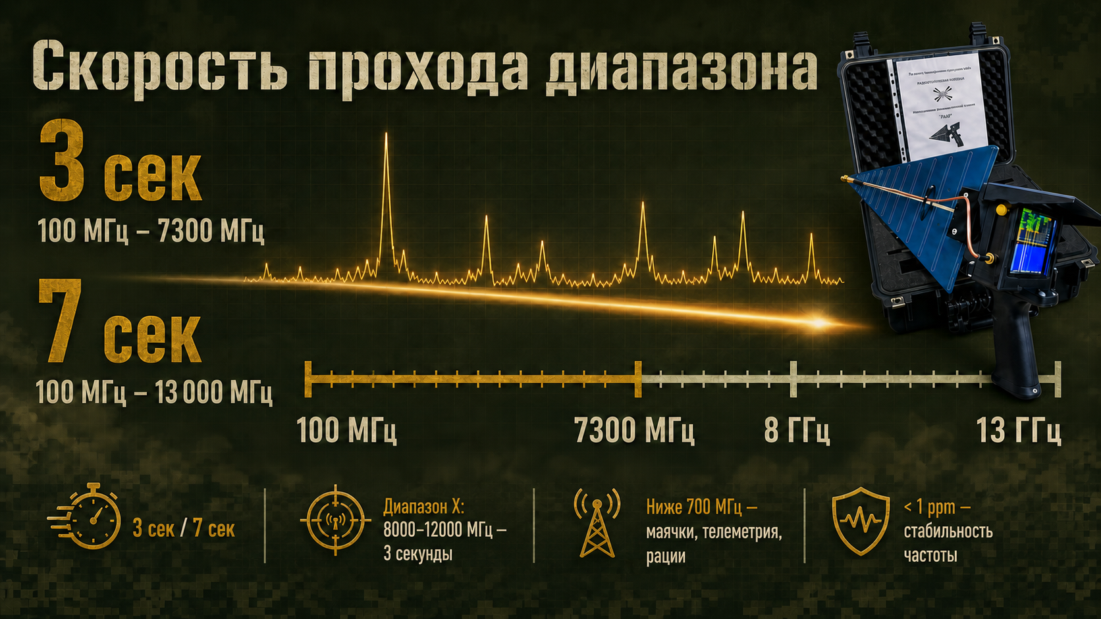
Notes:
[Sources]
- User-provided source: техническое описание РАДАРА v3.26.docx
- User-provided source: IMG_2762.JPG

Slide 7
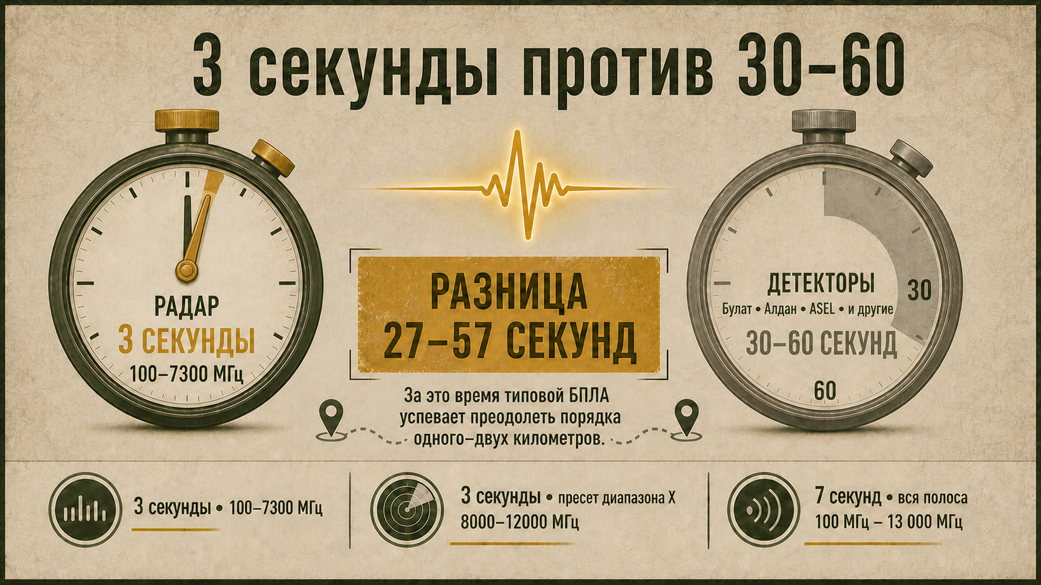
Notes:
[Sources]
- User-provided source: БРИФ_РАДАР.md
- User-provided source: РАДАР_презентация_v3.26.pdf

Slide 8
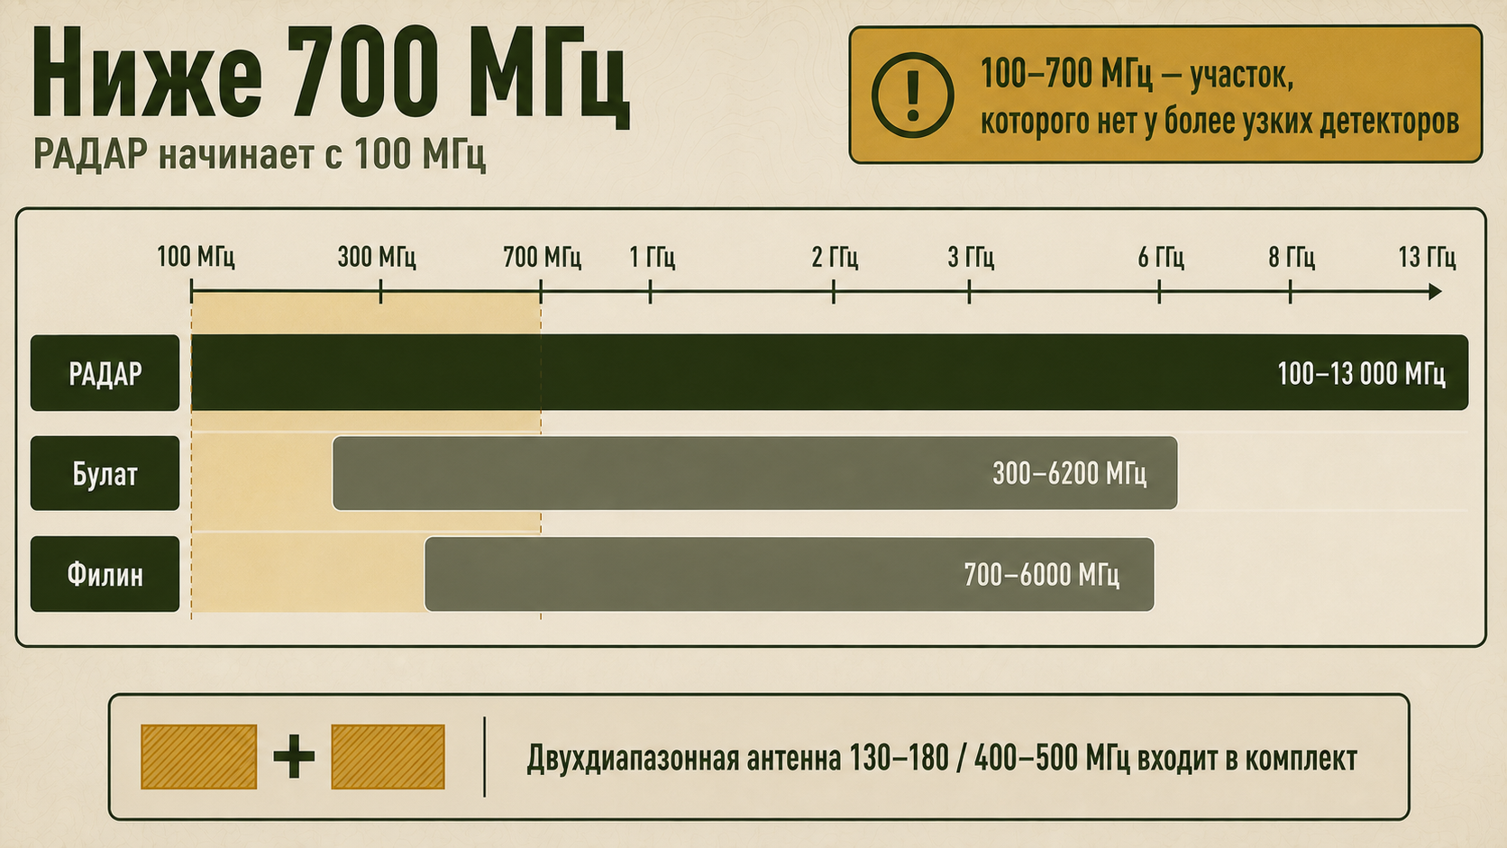
Notes:
[Sources]
- User-provided source: техническое описание РАДАРА v3.26.docx

Slide 9
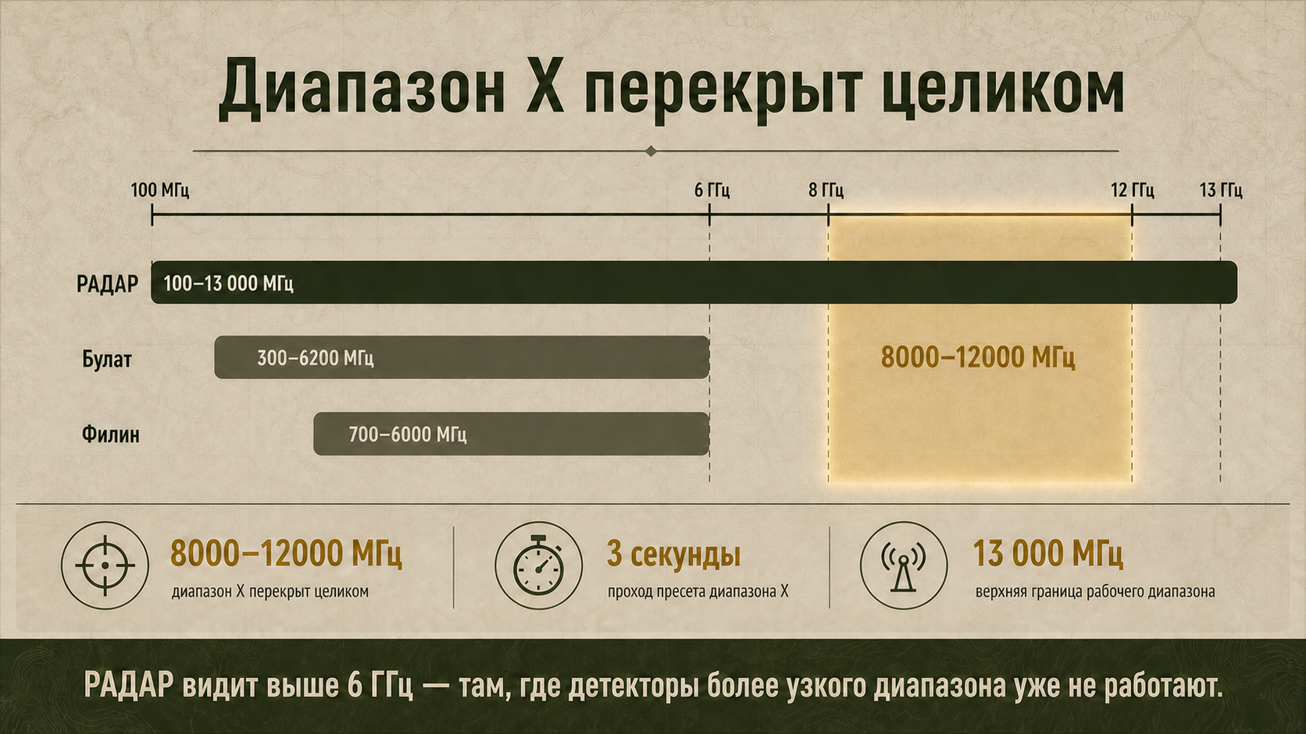
Notes:
[Sources]
- User-provided source: техническое описание РАДАРА v3.26.docx

Slide 10
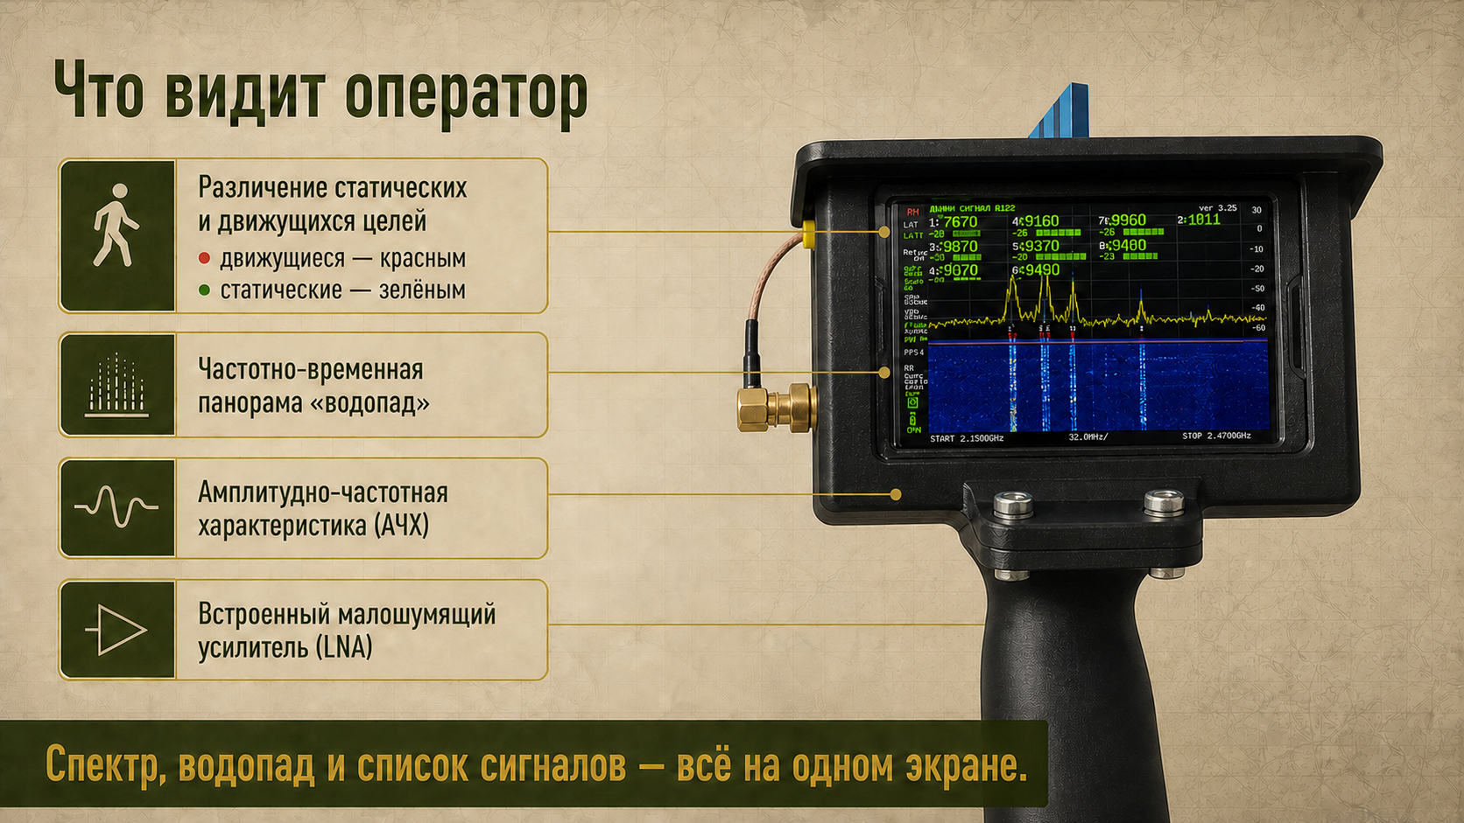
Notes:
[Sources]
- User-provided source: IMG_4807.jpg
- User-provided source: IMG_4809.PNG
- User-provided source: IMG_4808.PNG
- User-provided source: Снимок экрана 2026-08-22 в 15.00.10.png

Slide 11
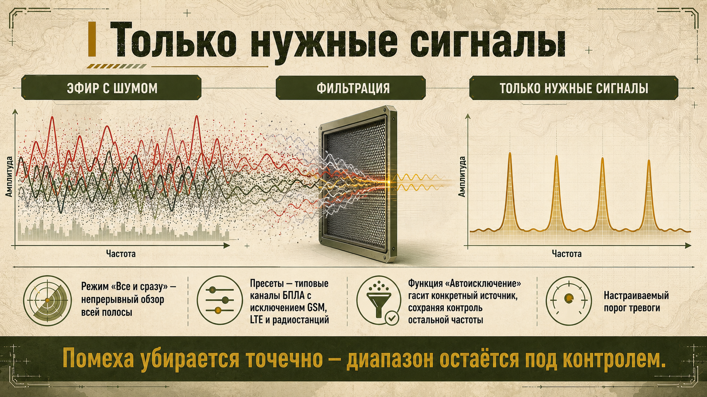
Notes:
[Sources]
- User-provided source: техническое описание РАДАРА v3.26.docx

Slide 12
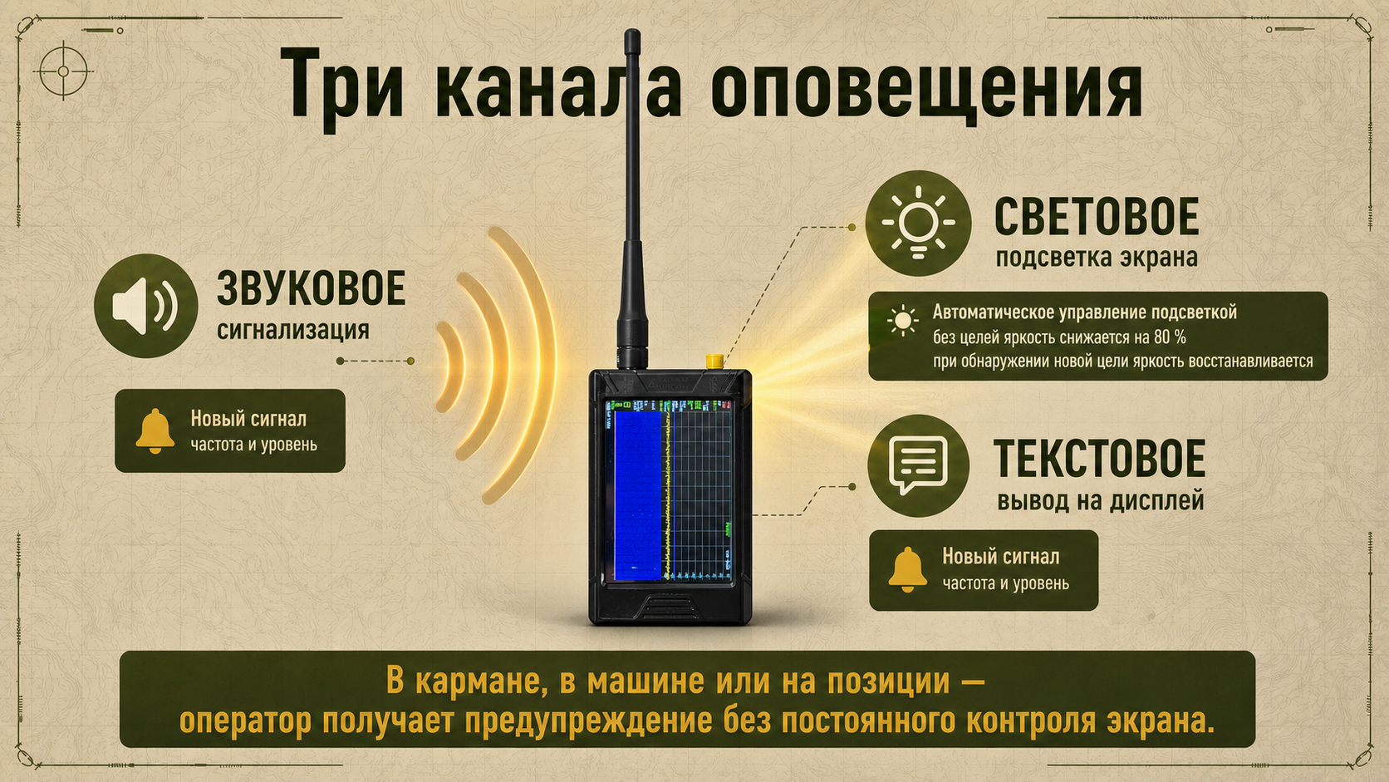
Notes:
[Sources]
- User-provided source: техническое описание РАДАРА v3.26.docx
- User-provided source: IMG_4648.HEIC

Slide 13
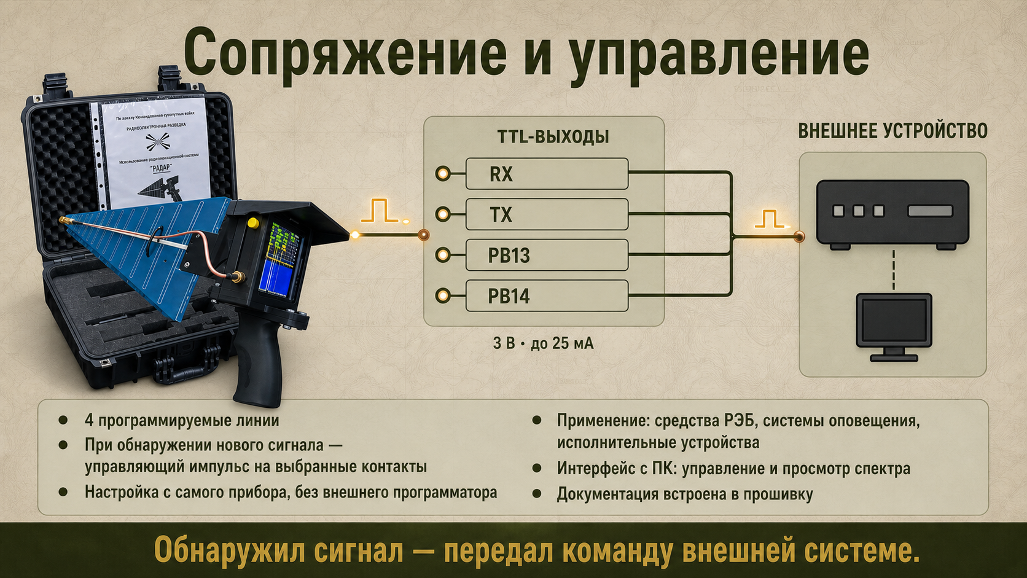
Notes:
[Sources]
- User-provided source: техническое описание РАДАРА v3.26.docx
- User-provided source: IMG_2762.JPG

Slide 14
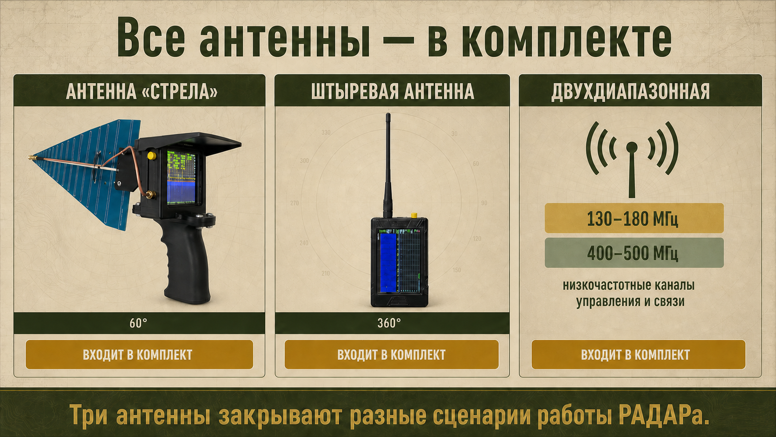
Notes:
[Sources]
- User-provided source: техническое описание РАДАРА v3.26.docx
- User-provided source: IMG_2762.JPG
- User-provided source: IMG_4648.HEIC

Slide 15
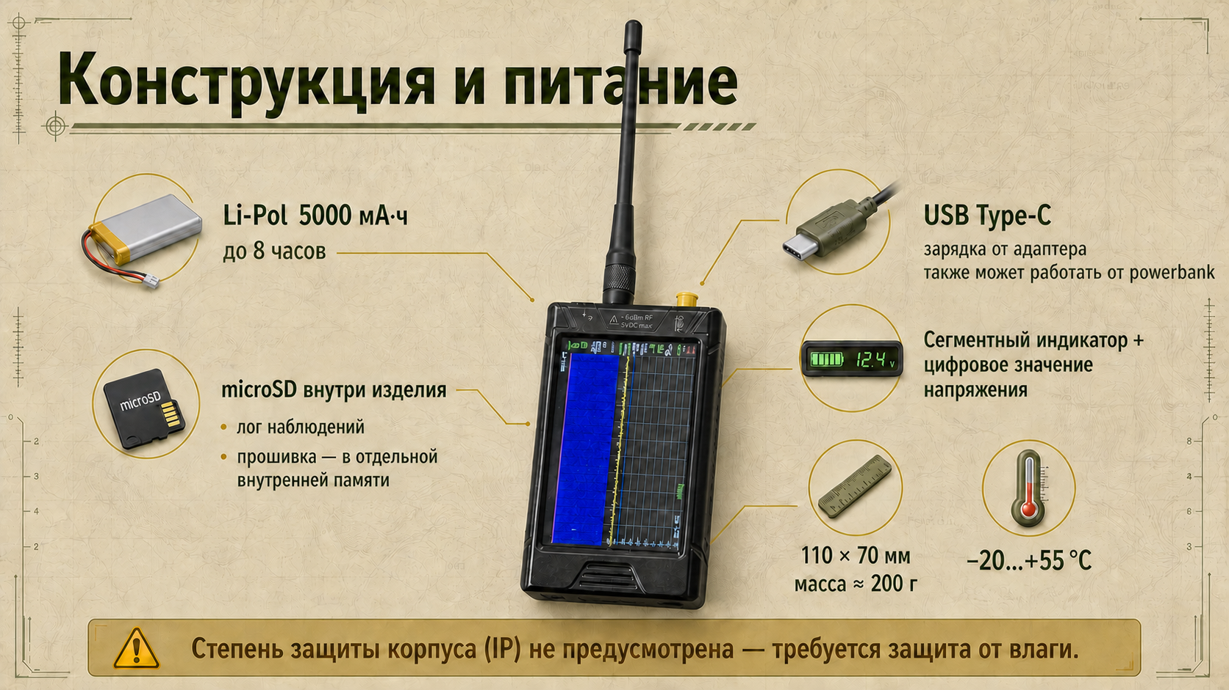
Notes:
[Sources]
- User-provided source: техническое описание РАДАРА v3.26.docx
- User-provided source: IMG_4648.HEIC

Slide 16
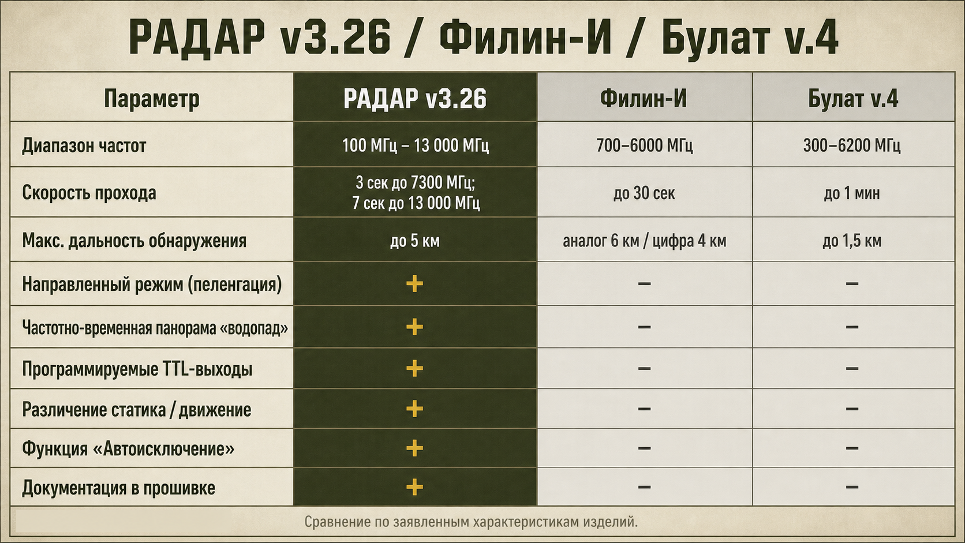
Notes:
[Sources]
- User-provided source: БРИФ_РАДАР.md
- User-provided source: РАДАР_презентация_v3.26.pdf

Slide 17
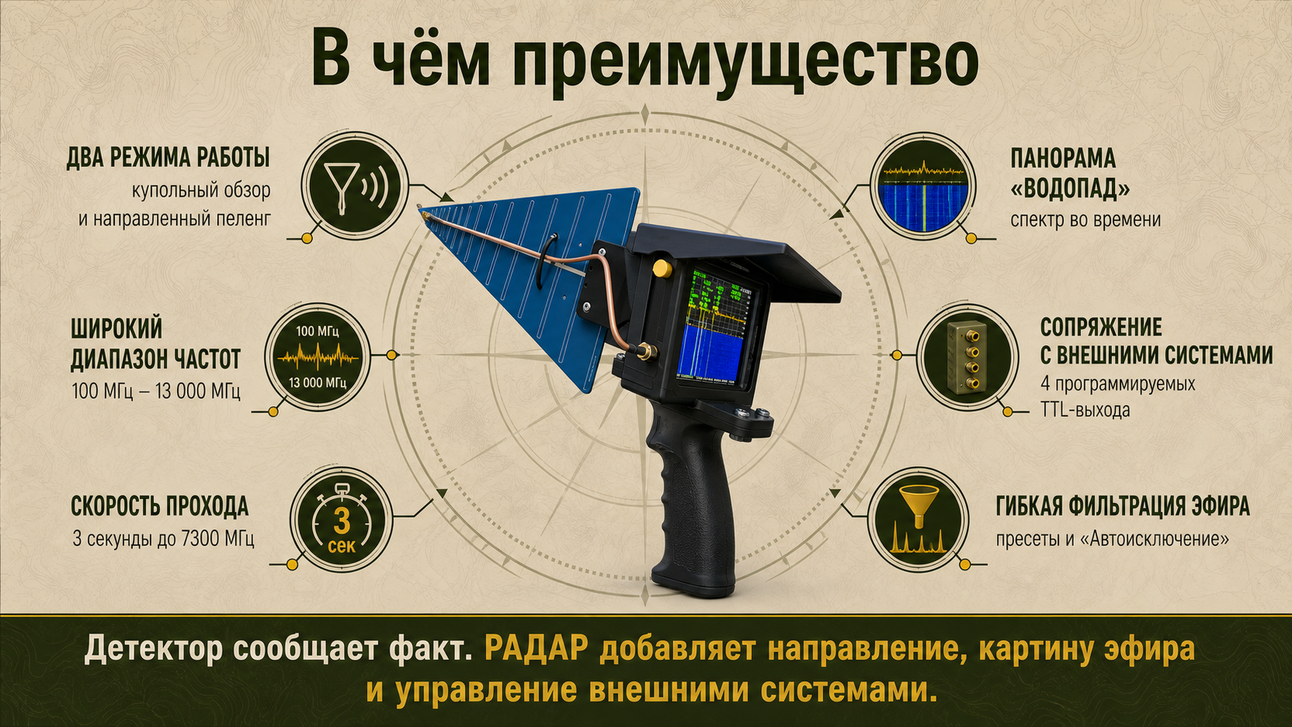
Notes:
[Sources]
- User-provided source: БРИФ_РАДАР.md
- User-provided source: IMG_2762.JPG

Slide 18

Notes:
[Sources]
- User-provided source: IMG_2763.JPG
- User-provided source: IMG_4809.PNG
- User-provided source: IMG_4808.PNG

